Slide 1
Biocalorimetry
- A powerful technique for the study of living systems
Dr. Malin Suurkuusk
Product Manager

Slide 2
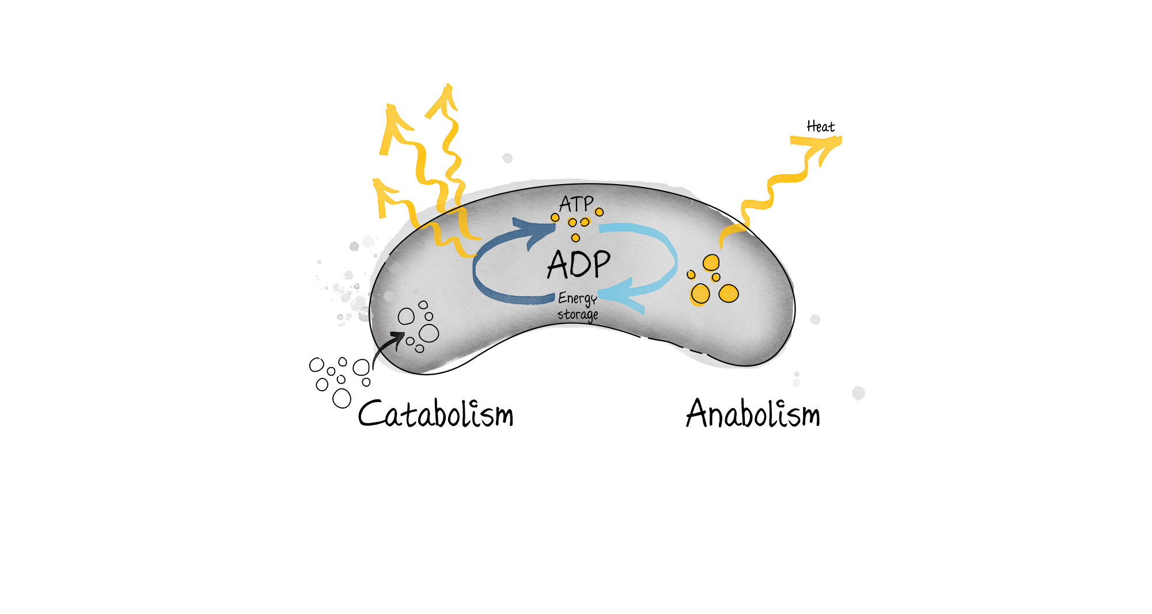
Biocalorimetry
– Calorimetry of living system
Calorimetry
Types of calorimetry
Calorimeter history
How do we measure
Why would you use it

Slide 3
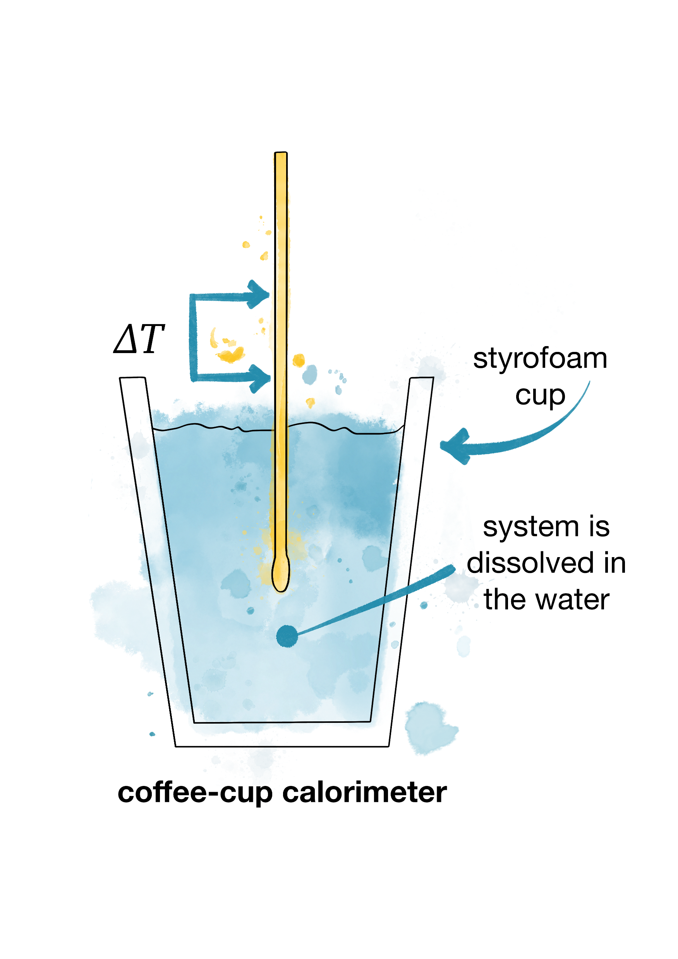
Calorimetry
Calorimetry is the science or technique of measuring changes in heat due to chemical reactions or physical processes.
Calorimetry comes from the Latin calor meaning heat and the Greek metron meaning to measure
Exotherm process
Heat is released
– it gets warm
Combustion
Oxidation
Crystallisation
Condensation
Metabolism
Endotherm process
Heat is consumed
– it gets cold
Evaporation
Melting
Desorption

Slide 4
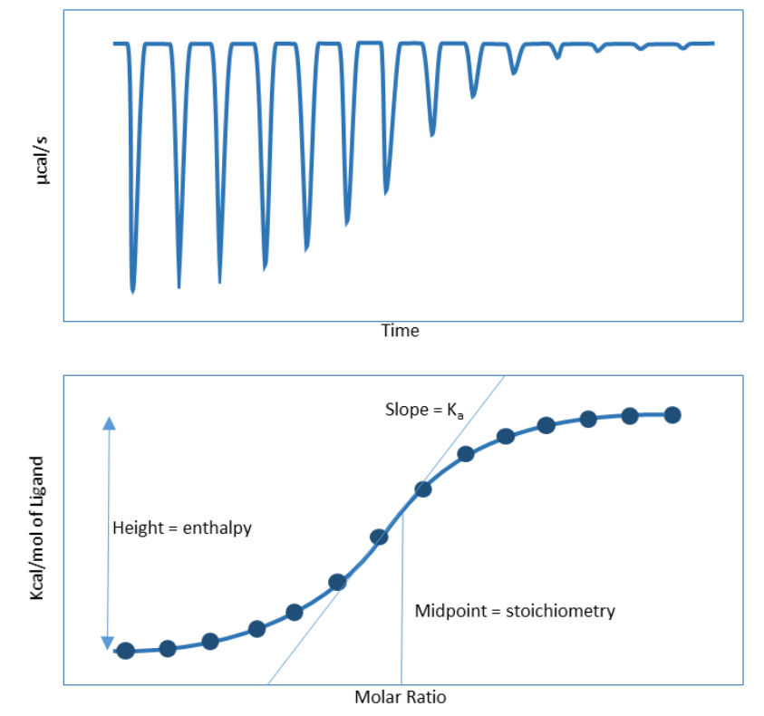
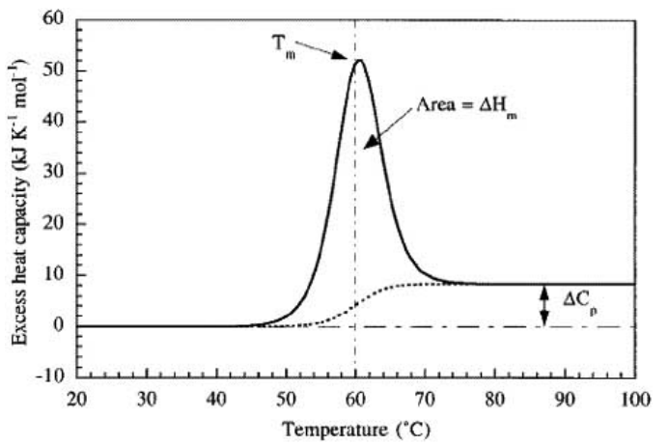
Types of calorimetry
Isothermal microcalorimetry – IMC
Heat flow calorimetry - HFC
Differential scanning calorimetry – DSC
Isothermal titration calorimetry – ITC
Bombcalorimetry
Accelerated rate calorimetry – ARC
Solution Calorimetry
Reaction calorimetry
Indirect calorimetry

Slide 5
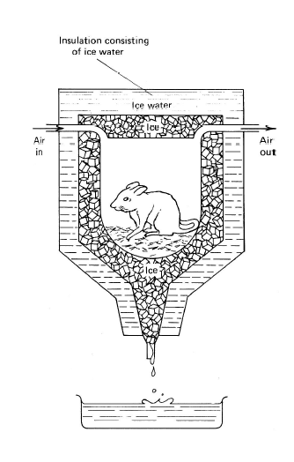
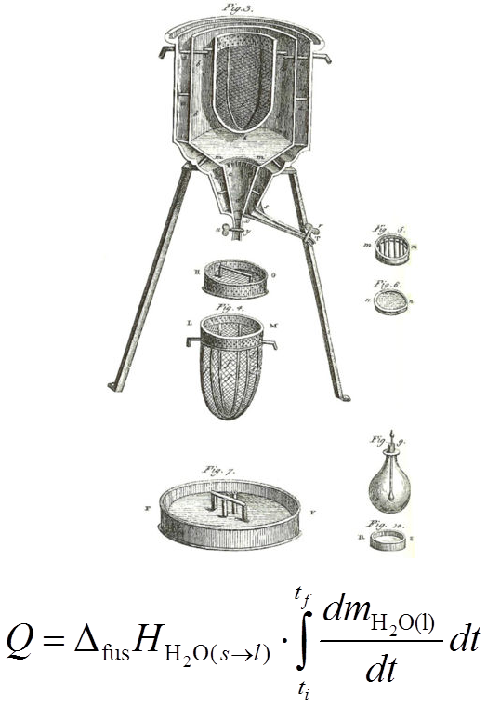
It started already 240 years ago
The very first calorimetric measurement was conducted in by Antoine Lavoisier and Pierre-Simon Laplace. This was in the winter 1782-83
They proved that respiration is a slow combustion process:
”La respiration est donc une combustion, à la vérité fort lente” - Respiration is thus a combustion, a slow one to be precise
Notes:
Measured heat released in various combustion reactions including animal respiration processes. Animals were placed in the calorimeter and the amount of ice melted was compared to the amount melted as charcoal was burned in a similar calorimeter. Oxygen intake and carbon dioxide (fixed air) production were also recorded and compared to the ratios of these two gases involved when the charcoal burned. Lavoisier and LaPlace concluded that the combustion of food in the animals body supplied the heat to maintain its body temperature much as burning charcoal released heat through its oxidation.

Slide 6
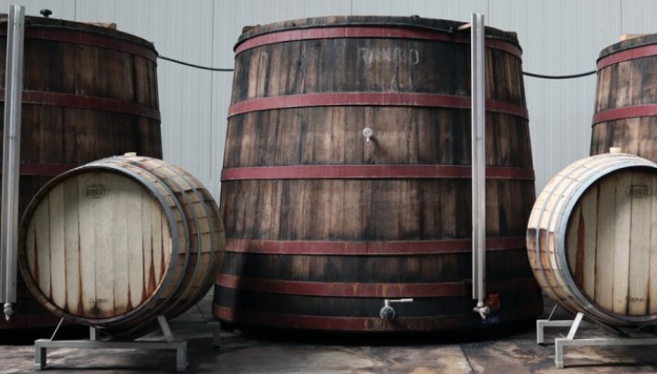
…. and then about 75 years later
The first calorimetric measurement on a microbial system was performed 1856.
Dubrunfaut determined the heat production accompanying alcoholic fermentation by measuring the temperature increase in an oak fermentor
Dubrunfaut, M. Note sur la chaleur et
le travail mecanique produits par
la fermentation vineuse
C R Acad. Sci. 1856;42:945-948

Slide 7
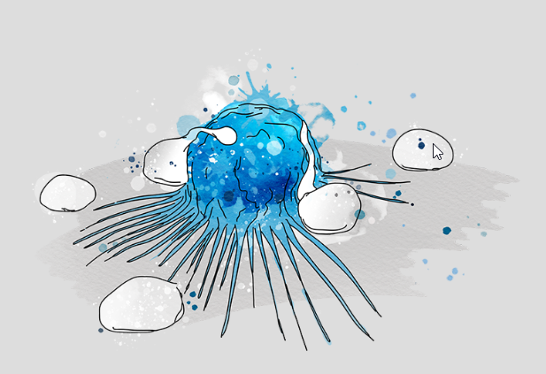
… after that it took more than 100 years
Increased interest in biocalorimetry during the 1960s, 70s and 80s
  In microbiology
  In medicine for the study of
    Blood cells
    Cancer cells
    Fat cells
    Immune complexes
    Muscle fiber bundles
    Biocompatibility

Slide 8
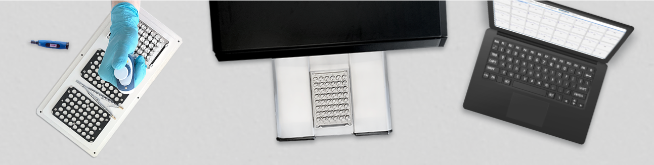
Today
- the renaissance of biocalorimetry

Slide 9
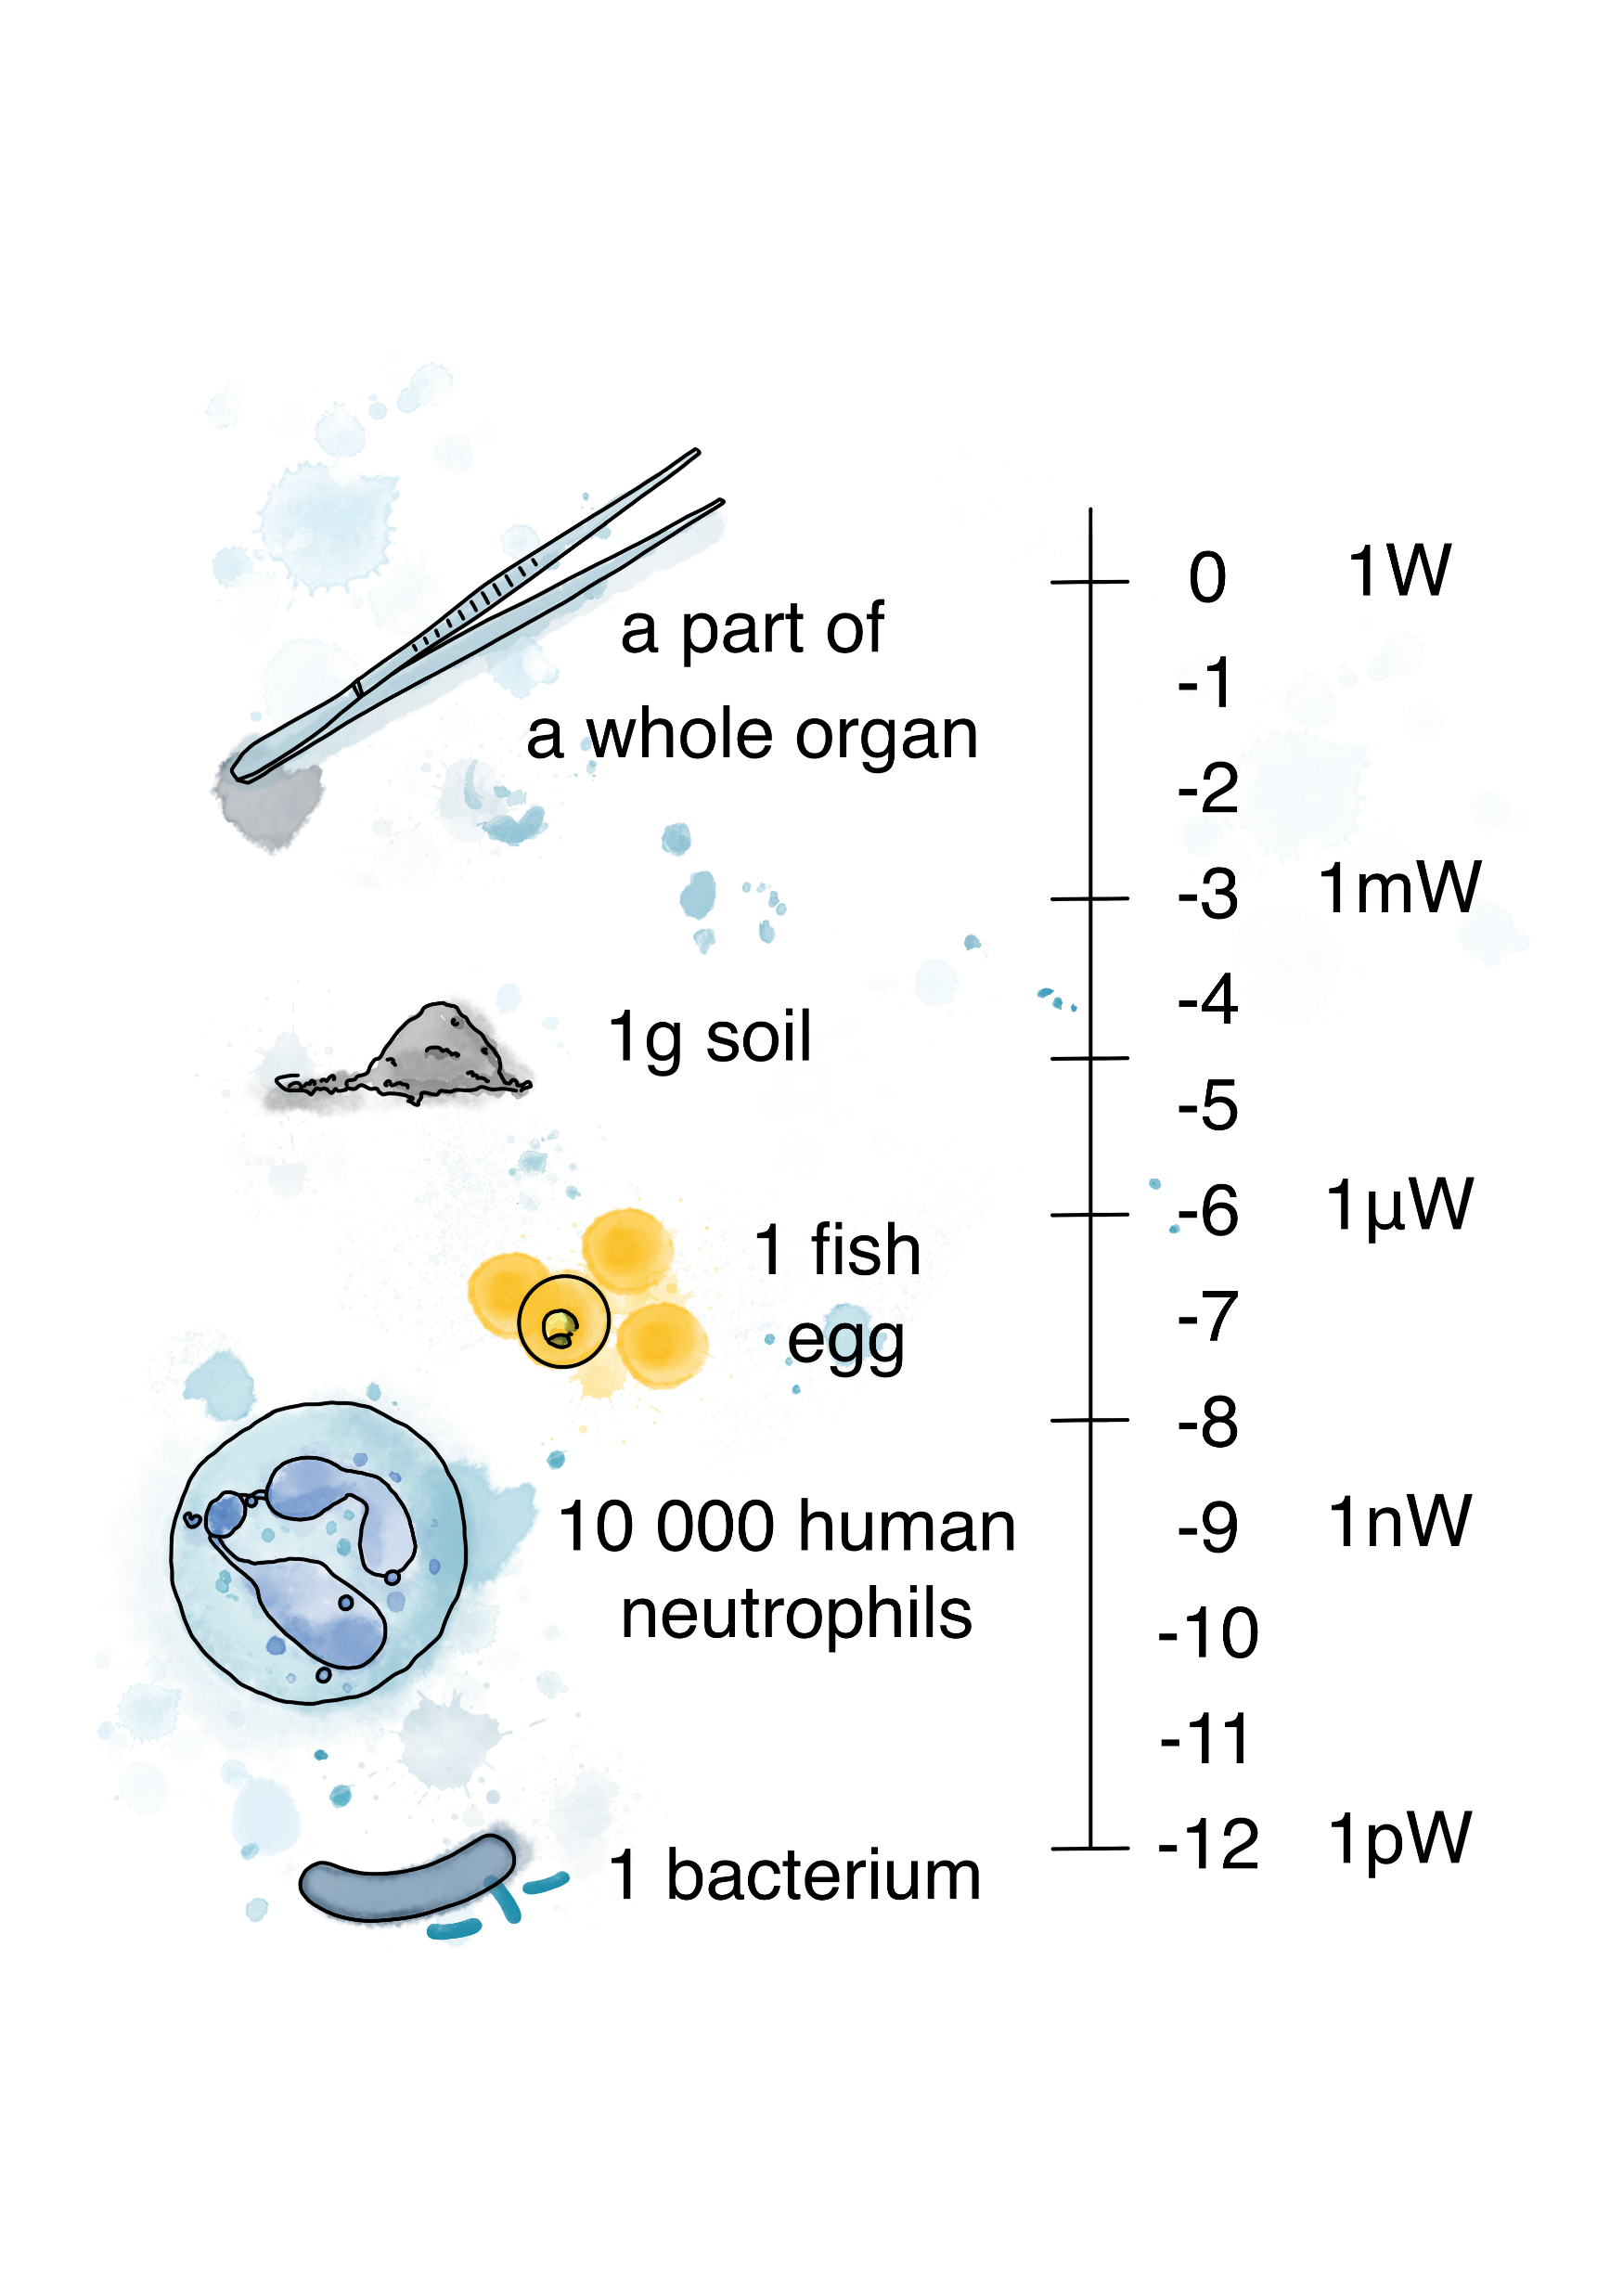
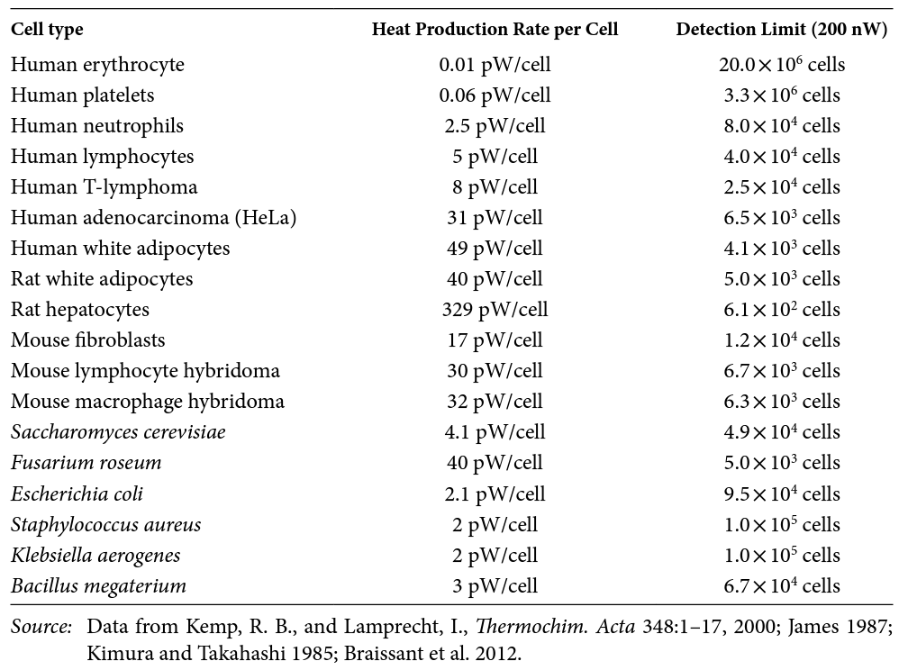
If there is life, there is heat

Slide 10
Biocalorimetry &
Isothermal microcalorimetry
Heat flow is a rate
W = J/s (cal/s)
Heat flow is directly proportional to the rate or intensity of the process(es) studied
Heat is an amount
Joules, J (calories, cal)
Heat is directly proportional to the extent of the process(es) studied

Slide 11
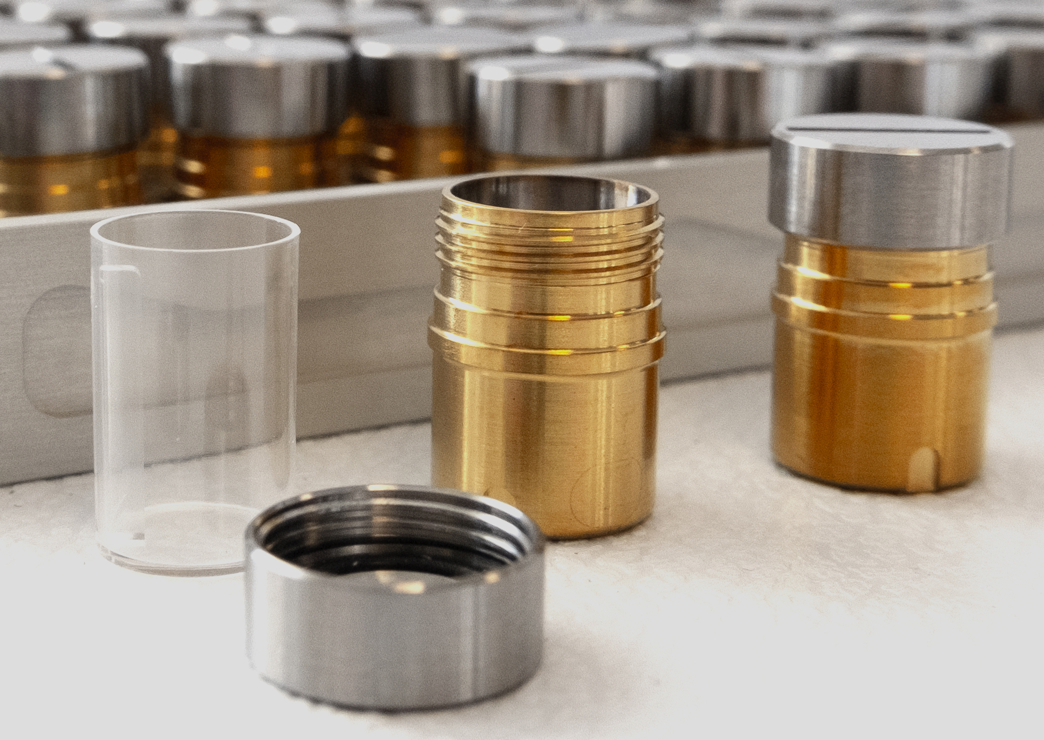
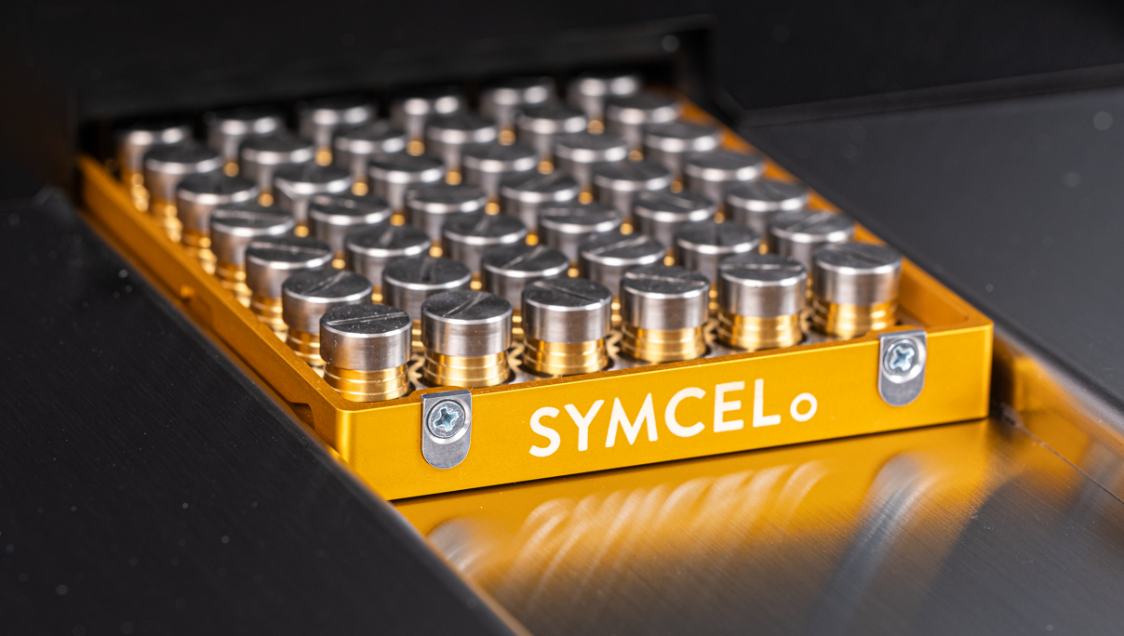
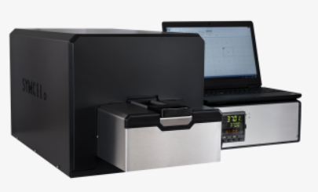
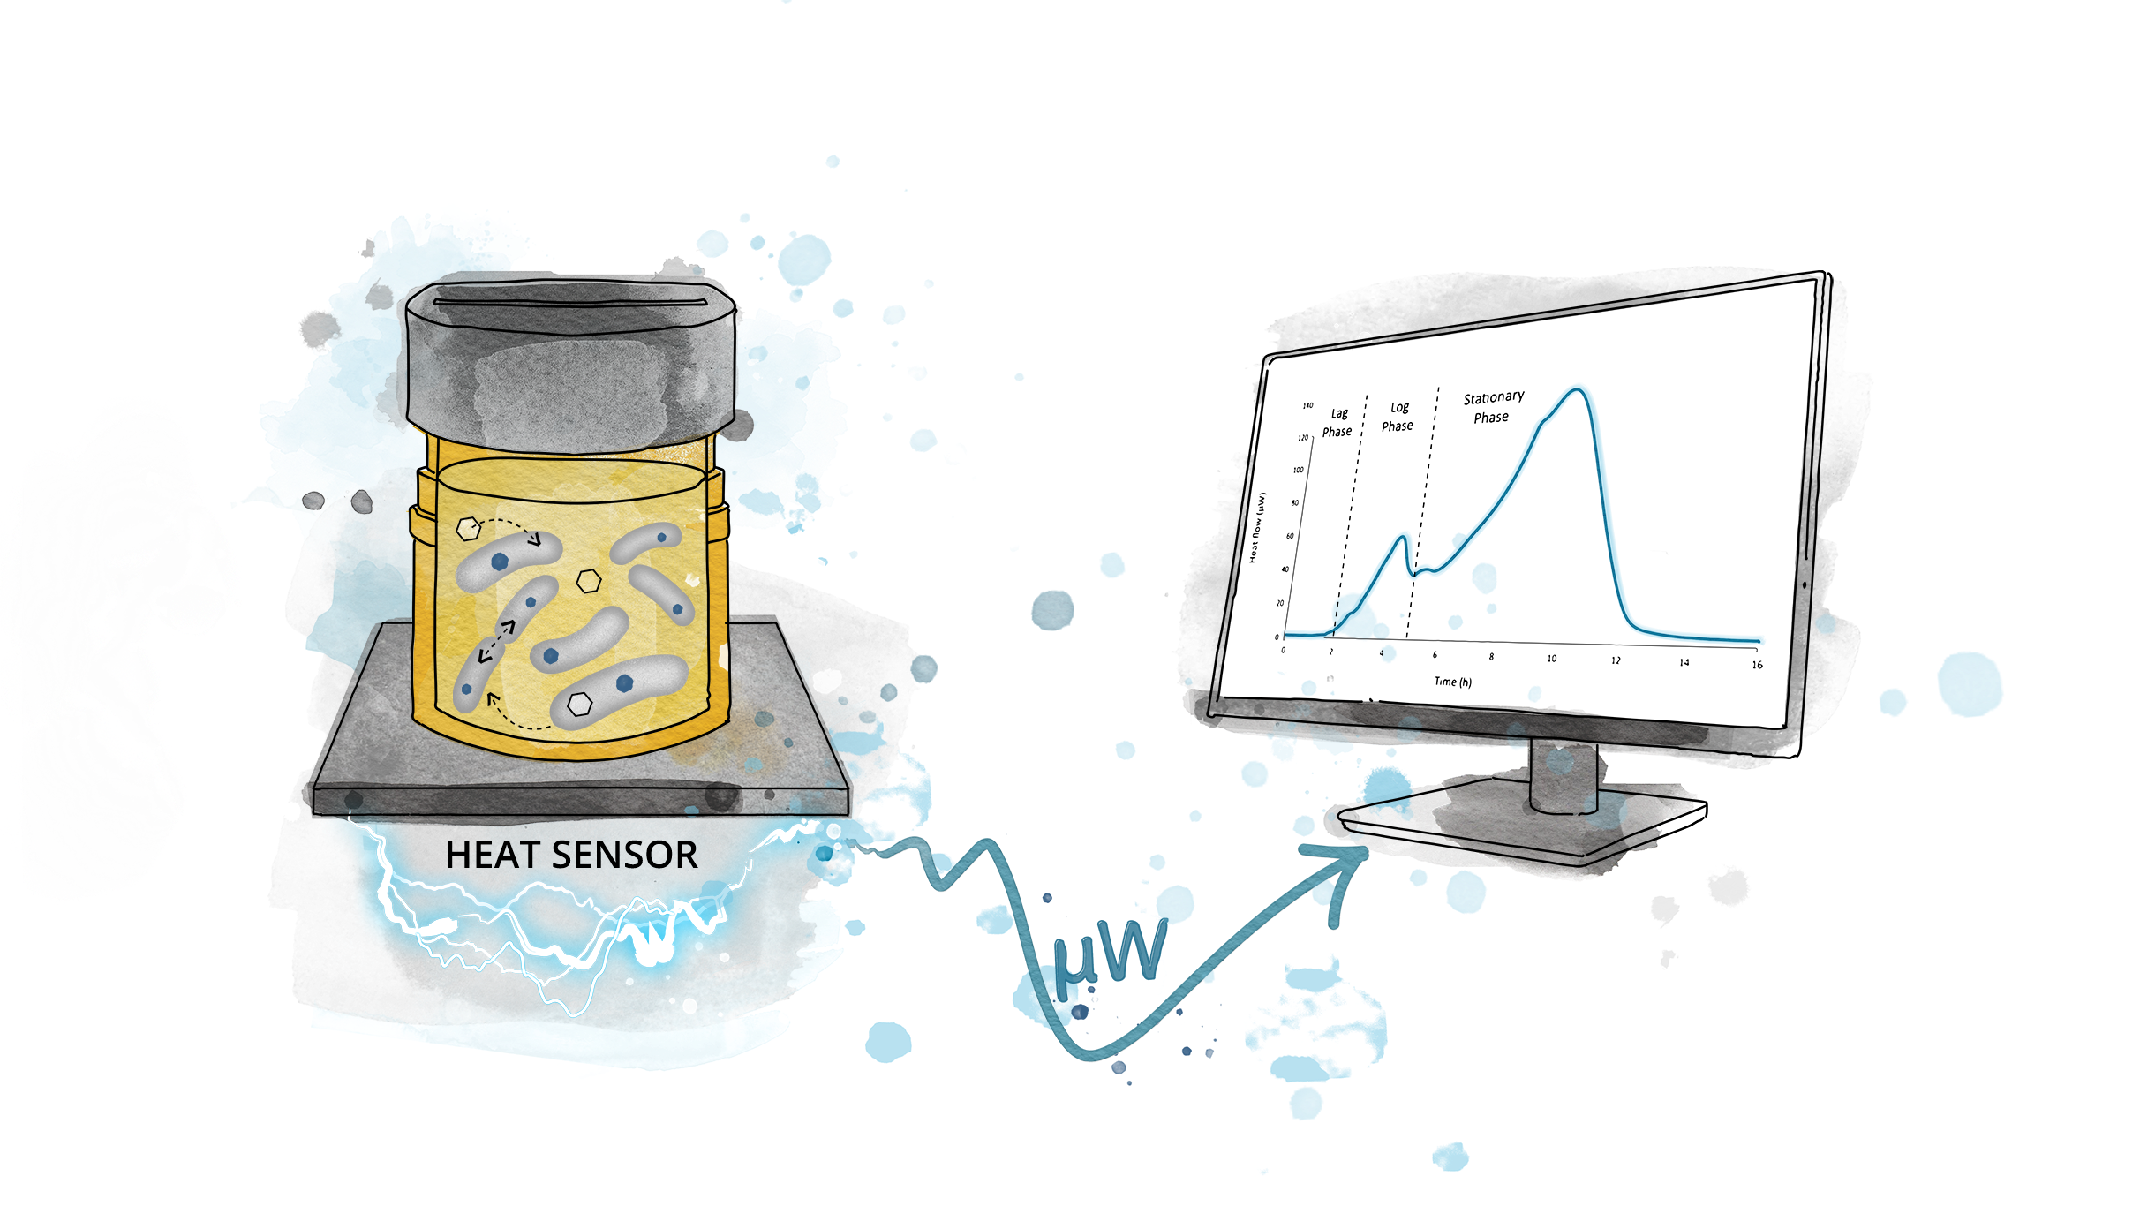
Our biocalorimetry solution
– The calScreener
48-channel isothermal microcalorimeter
32 parallel samples
100-600 µL sample volumes
37 (29-42) °C

Slide 12
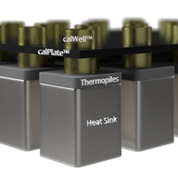
The measuring principle
Heat production, P, is related to the measured heat flow, φ, through the heat balance equation.
where
      φ = k(T₀-T_{S})
The temperature difference generates a voltage signal in the detector according to the Seebeck effect. This signal is measured and converted into the heat flow signal
All heat flow microcalorimeters are twin calorimeters, ie sample is measured against an inert reference
_{dt}
=
Φ
+
_{C}⎛ dT ⎞
P
⎝ ⎠
T_{S}
P
T₀

Slide 13
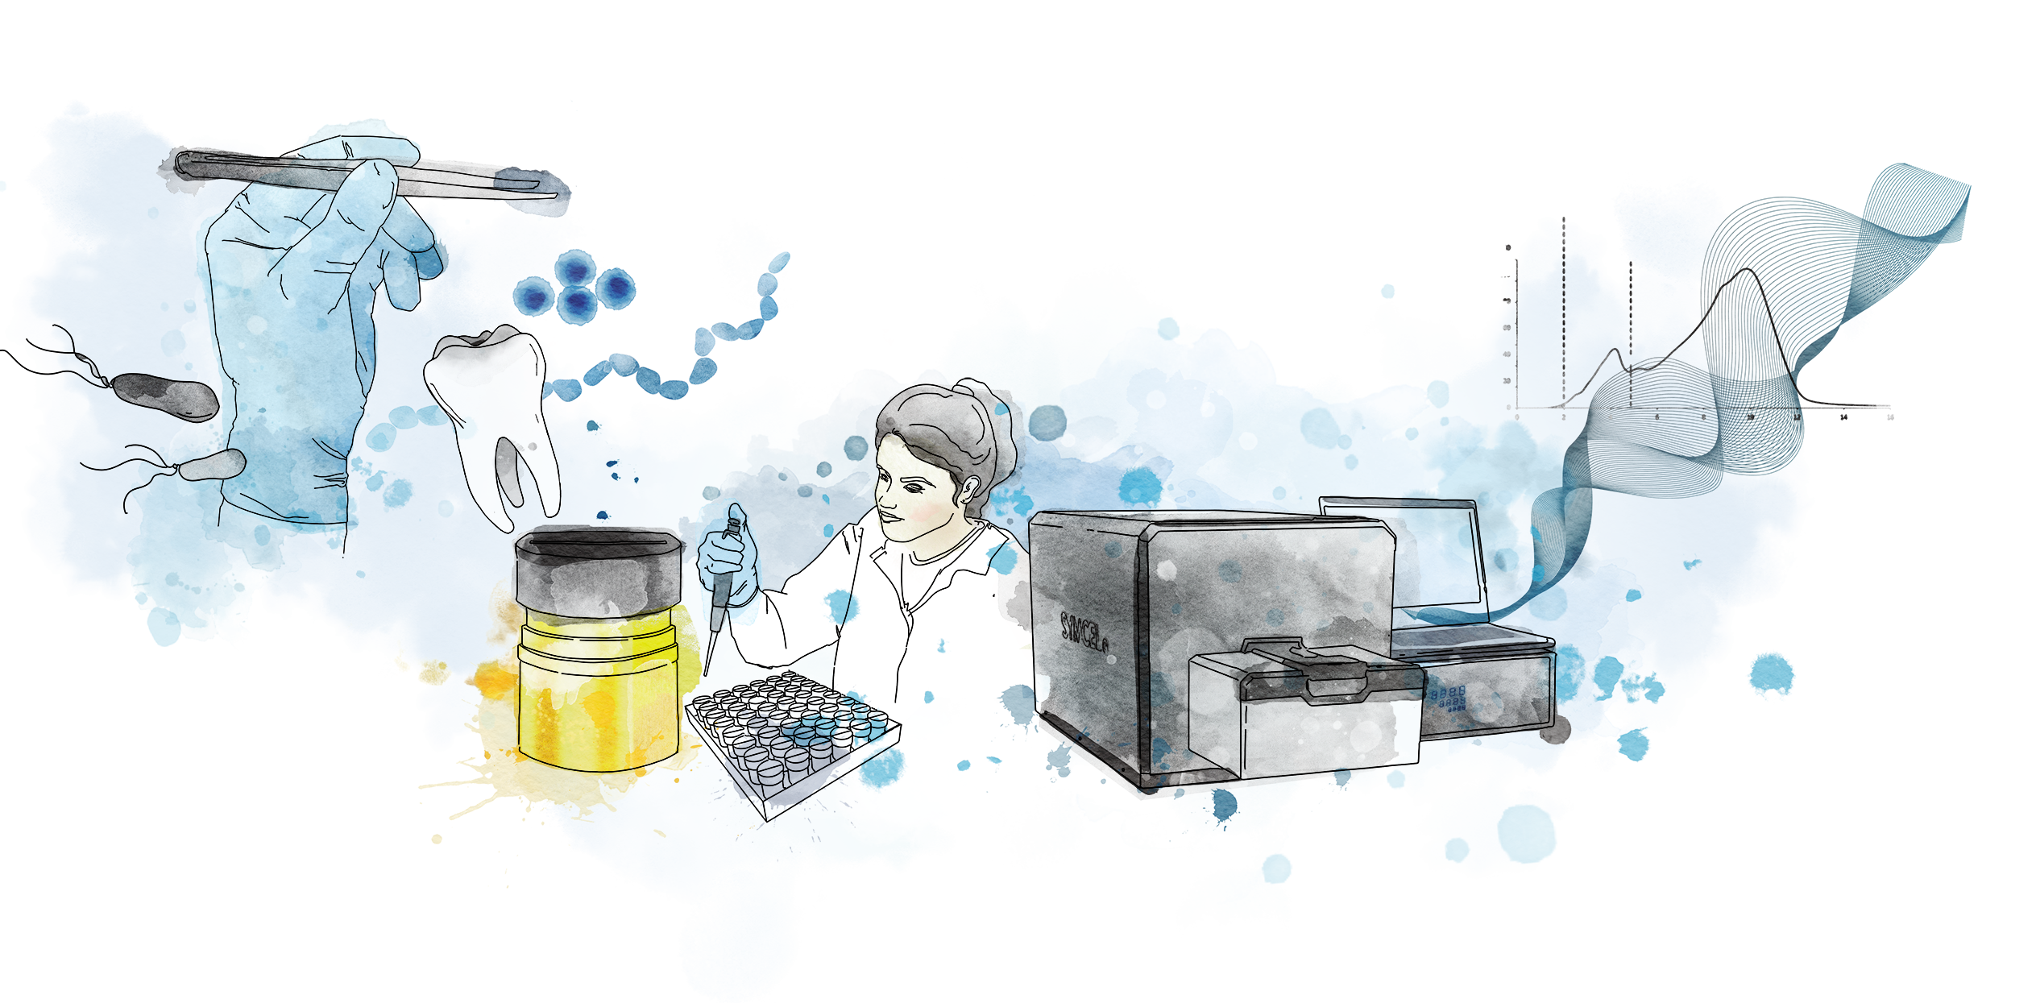
Biocalorimetry is simple and its labelfree
1
Insert any biological material in our medical-grade titanium cups
3
Start the experiment and monitor the metabolic activity using calView™
2
Insert the 48-well calPlate™ inside the calScreener™

Slide 14
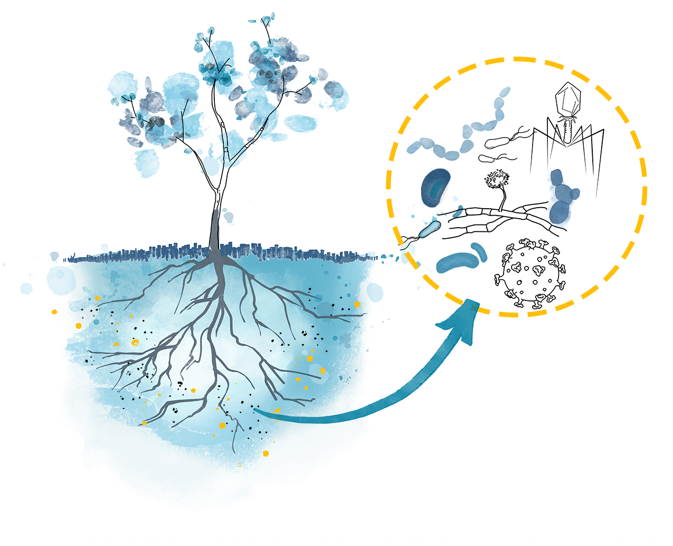
Biocalorimetry is sample independent
Opaque, viscous or solid media
Body fluids with any community composition
Any kind of cells or tissues
Soil, seed or small plants
Parasites
Complex communities
In normoxia, hypoxia and anoxia
Biomaterials

Slide 15
Biocalorimetry is fast and highly sensitive
10⁴
10⁷
10³
10²
detection time correlates to inoculum size
10⁵
10
10⁶
E. coli inoculum size
Notes:
The inoculum size affects the lag phase and there s a linearity with time to detection.

Slide 16
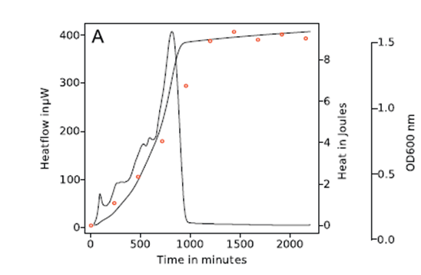
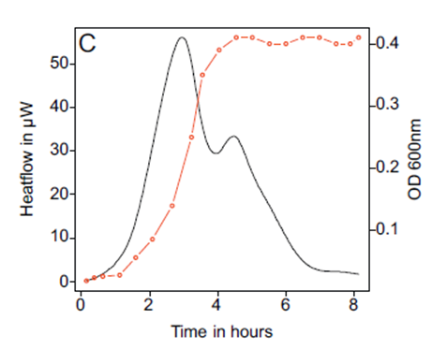
Biocalorimetry is direct and continuous
See what happens when it happens
No sampling – kinetic information
Not an endpoint measurement

Slide 17

Heat does not come in different colors
The general and non-destructive nature of heat measurements makes calorimetry an ideal detector of unknown phenomena.
Detect complex events which otherwise
may escape unnoticed
However, calorimetric results contain
no specific information about the
detected phenomena

Slide 18
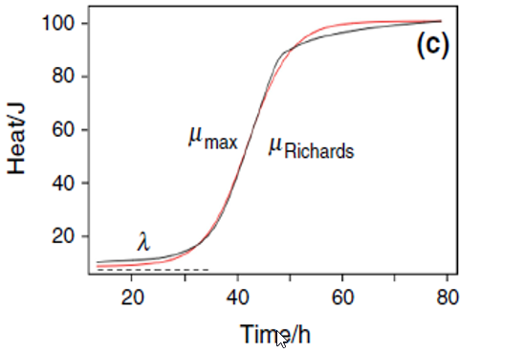
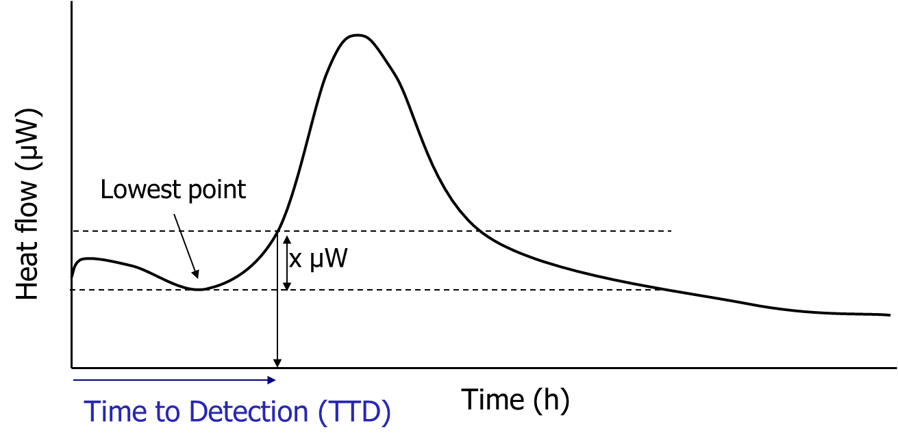
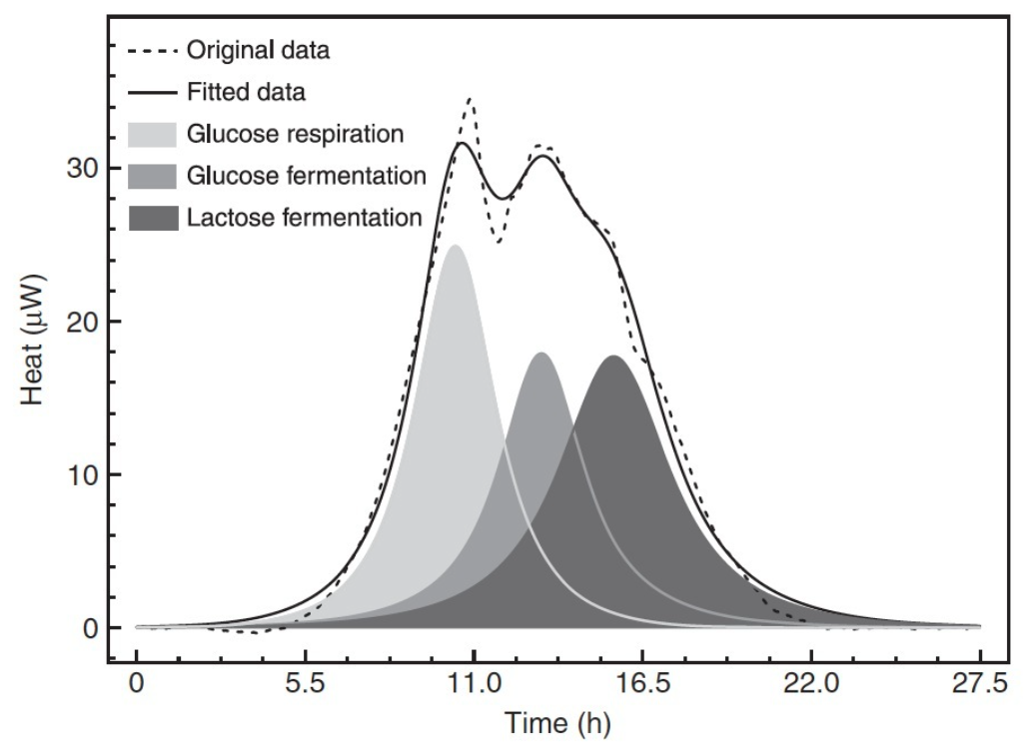
A unique & informationrich technique
Peak height
Time to peak (TTP)
Area under curve

Slide 19
Qualitative and Quantitative Analysis
Microorganisms
Cells
Metabolism & Growth
Biofilm formation
Detection
Identification
AST
Fingerprinting
Metabolism
Proliferation
Comparative
Ranking
Effect of treatments

Slide 20
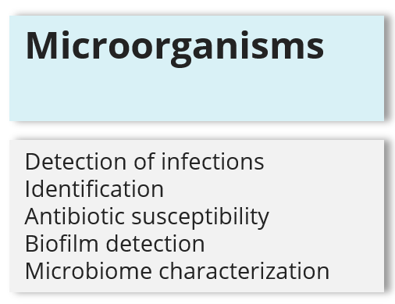
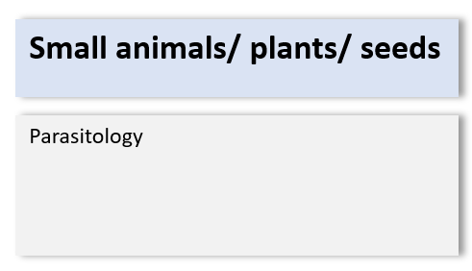
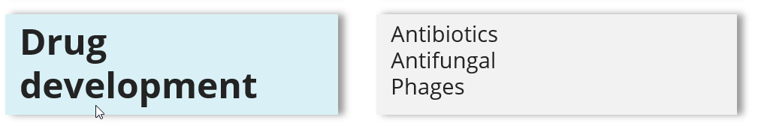
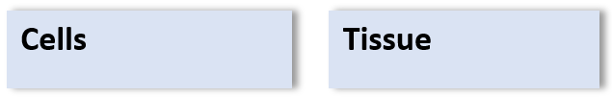
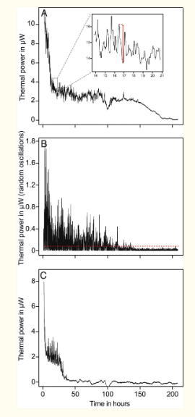

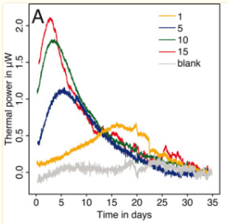
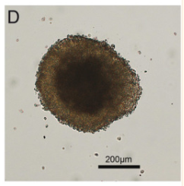
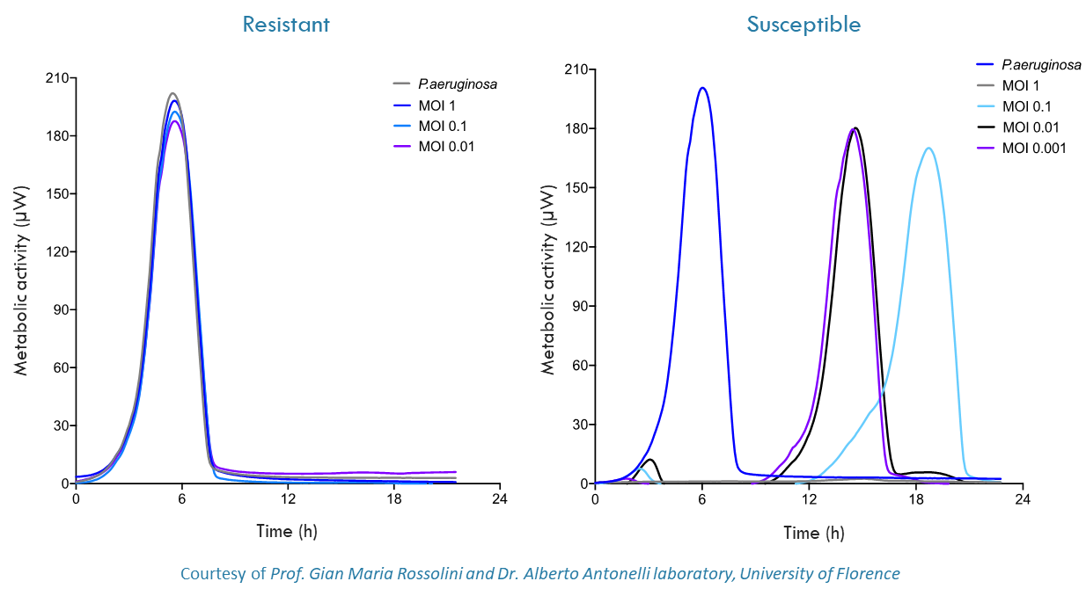
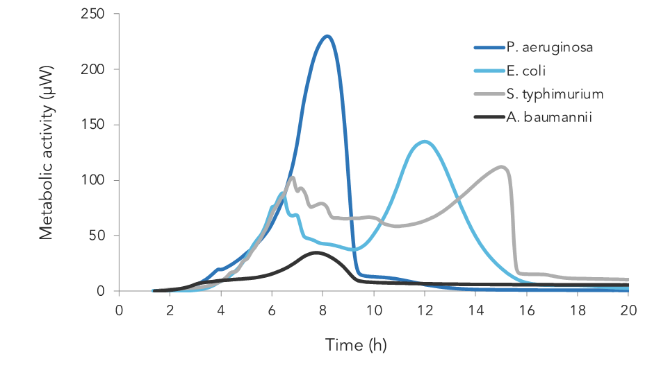
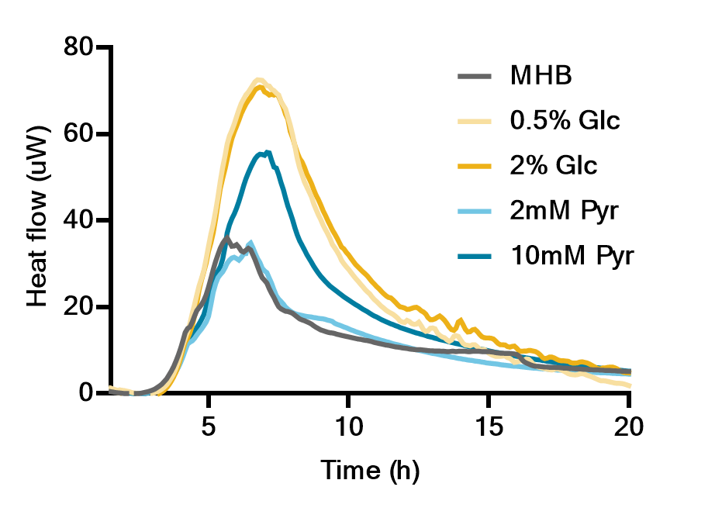
Schistosoma metabolic
and motor activity
Mueller-Hinton broth
 |  | Microorganisms |  | Cells |  | Tissue |  | Small animals/ plants/ seeds
Medical |  | Detection of infections Identification Antibiotic susceptibility Biofilm detection Microbiome characterization |  | Proliferation Thermogenesis Biocompatibility |  | Drug response Anticancer treatments Biocompatibility |  | Parasitology
Biopharma |  | Drug response Anticancer treatments Biocompatibility |  | Culture optimisation
Biotechnology |  | Culture optimisation Characterisation |  | Culture optimisation Characterisation |  | Culture optimisation
Food & Beverages |  | Spoilage / Food safety Fermentation Probiotics Charcterisation & optimization Cheese |  | Cultured meat |  | Metabolic activity - respiration - effect of preservatives - heat treatment - dehydration |  | Germination Viability
Medical devices |  | Biofilm and material coatings |  | Biocompatibility |  | Biocompatibility
Drug development |  | Antibiotics Antifungal Phages |  | Drug response Anticancer |  | Drug response Anticancer |  | Drug response Antiparasitics
Ecology/ agricultural |  | Soil / sediment characterisation Contamination Waste water treatment |  |  |  |  |  | Germination Effects of pesticides Effect of contamination
Other |  | Fungi on wood/buildingmaterials

Slide 21
 |  | Microorganisms |  | Cells |  | Tissue |  | Small animals/ plants/ seeds
Medical |  | Detection of infections Identification Antibiotic susceptibility Biofilm detection Microbiome characterization |  | Proliferation Thermogenesis Biocompatibility |  | Drug response Anticancer treatments Biocompatibility |  | Parasitology
Biopharma |  | Drug response Anticancer treatments Biocompatibility |  | Culture optimisation
Biotechnology |  | Culture optimisation Characterisation |  | Culture optimisation Characterisation |  | Culture optimisation
Food & Beverages |  | Spoilage / Food safety Fermentation Probiotics Charcterisation & optimization Cheese |  | Cultured meat |  | Metabolic activity - respiration - effect of preservatives - heat treatment - dehydration |  | Germination Viability
Medical devices |  | Biofilm and material coatings |  | Biocompatibility |  | Biocompatibility
Drug development |  | Antibiotics Antifungal Phages |  | Drug response Anticancer |  | Drug response Anticancer |  | Drug response Antiparasitics
Ecology/ agricultural |  | Soil / sediment characterisation Contamination Waste water treatment |  |  |  |  |  | Germination Effects of pesticides Effect of contamination
Other |  | Fungi on wood/buildingmaterials

Slide 22
Biocalorimetry going forward
The full potential of biocalorimetry is still being explored
Great opportunities for qualitative investigations
The future of biocalorimetry depends less on instrument improvements but more on the interpretation of data from complex system
The increased knowledge of processes in complex system opens the possibility of interpreting calorimetric data not only in phenomenological terms but also quantitatively

Slide 23
To conclude
Almost a quarter of a millennium since the very first biocalorimetry experiment was conducted we are in “The century of biology”, and there is an ever-increasing interest in and understanding of how biocalorimetry can be used
  Universal & extremely sensitive
  One method – independent of expected response
  Metabolic activity and growth from the same experiment
  Direct & continuous information for a kinetic profile
  Multichannel for increased throughput

Slide 24
Want to know more?
Connect with us for more information
www.symcel.com
malin.suurkuusk@symcel.com

